Slide 1
Intelligent Resource Optimization System (IROS) Overview
Welcome to the Intelligent Resource Optimization System (IROS) overview. IROS is designed to revolutionize manufacturing operations by driving significant efficiency improvements through advanced agent-based architecture.
Driving 15% operational efficiency in manufacturing
Agent-based architecture for dynamic resource allocation
Centralized orchestration via Master Control Program (MCP)
Project successfully deployed across 3 production lines

Slide 2
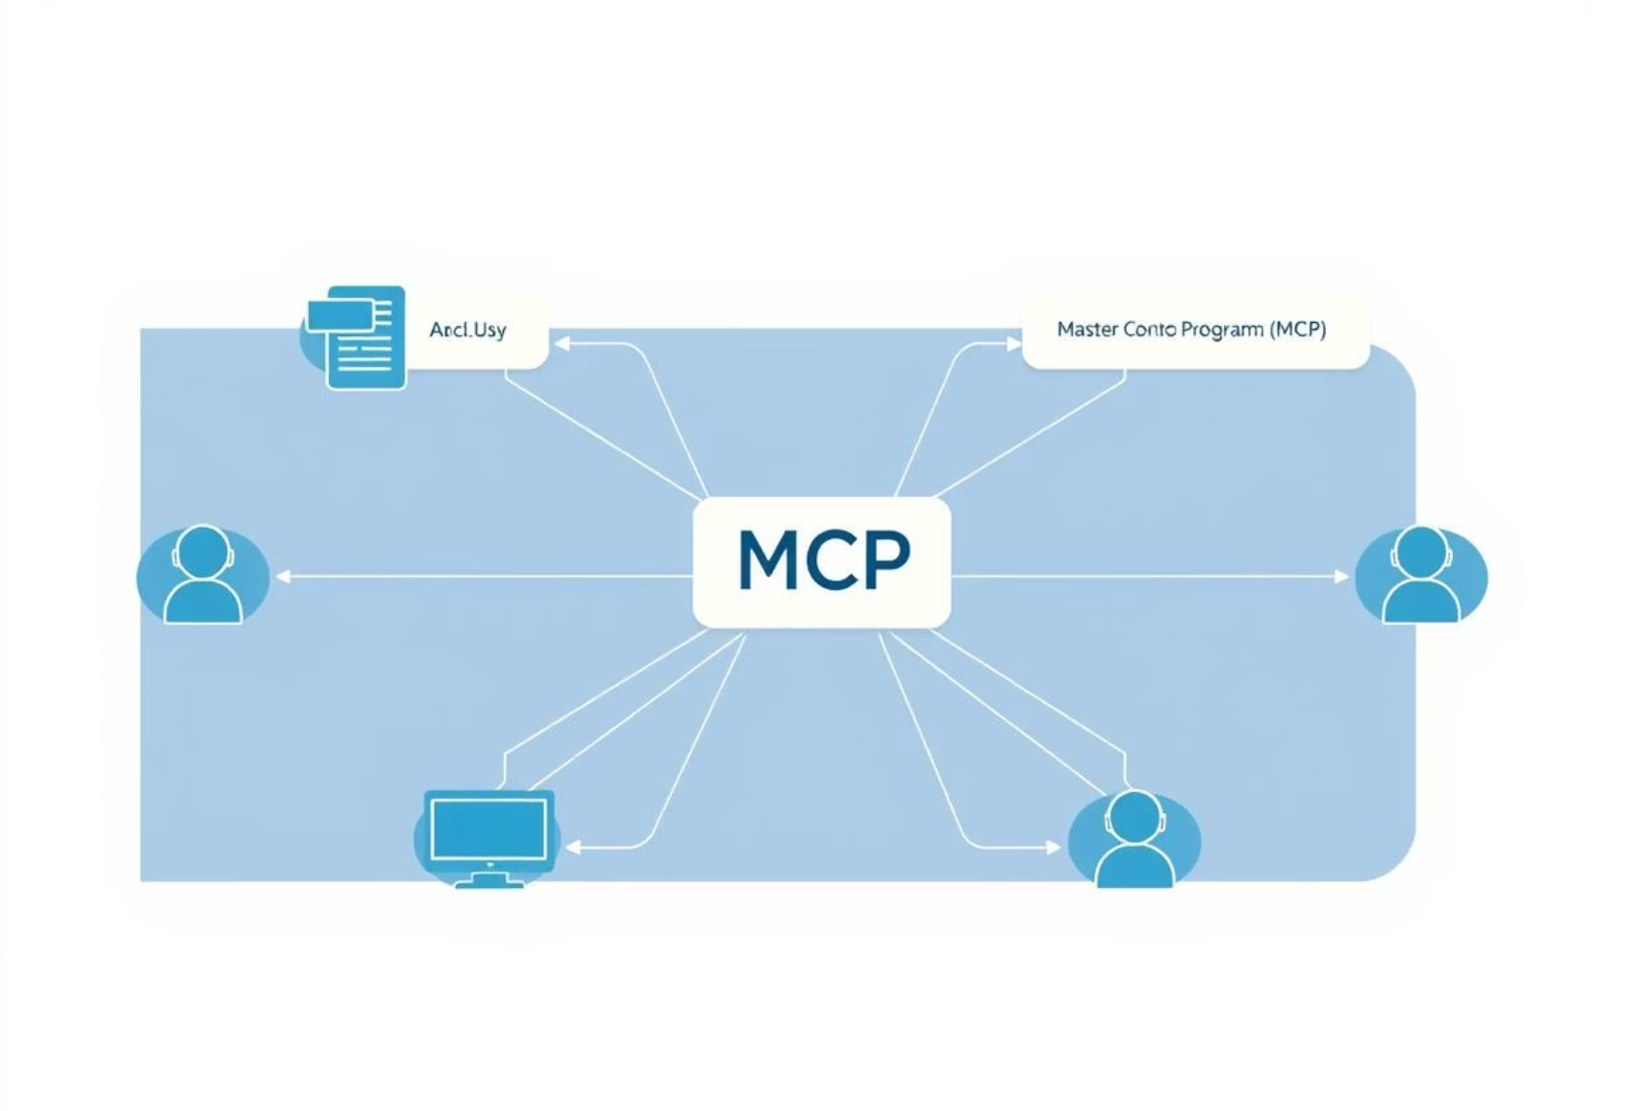
Agent-Based Architecture & MCP Integration
IROS leverages a sophisticated agent-based architecture for decentralized yet coordinated resource management, with the Master Control Program (MCP) at its core.
Autonomous Agents
Decentralized units for specific tasks (e.g., Inventory Agent, Production Agent, Energy Agent).
Each agent operates independently, yet cooperatively, to optimize its domain.
Master Control Program (MCP)
Centralized orchestrator, coordinating 50+ agents via FIPA ACL messages.
Acts as a blackboard/broker for efficient request routing.
Integration Principle
MCP routes requests and responses, ensuring seamless communication and data exchange.
Scalability
New agents can be onboarded in less than 2 hours without system downtime, ensuring agile expansion.

Slide 3








System Flow Diagram: Production Optimization Request
This diagram illustrates the step-by-step process of how IROS handles a production optimization request, from user input to optimal plan delivery, highlighting key agent interactions and message passing.
User Request
Production Manager submits "Optimize Production Run 007" via UI.
UI Agent
Forwards request to Orchestration MCP via secure REST API.
Orchestration MCP
Broadcasts request for production capacity to relevant Production Agents.
Production Agents
Respond with real-time capacity and material needs.
Inventory Agent
Checks raw material availability based on Production Agent inputs.
Energy Agent
Simulates energy cost for proposed production run.
Orchestration MCP
Consolidates responses, sends optimal plan to UI Agent.
Message Passing
Asynchronous communication via RabbitMQ for robust delivery.

Slide 4
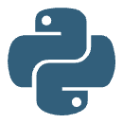





Core Technology Stack
IROS is built on a robust and scalable technology stack, carefully selected to ensure high performance, reliability, and ease of development and deployment.
Agent Framework
Message Broker
Custom Python 3.9 framework with async I/O for efficient agent operations.
RabbitMQ 3.11 for reliable, persistent message queues (5000+ messages/sec throughput).
Master Control Program
Database
Java 17 Spring Boot application for high concurrency and resilience.
PostgreSQL 14 for agent states and historical operational data (1TB+ stored).
Frontend
Deployment
React 18 for interactive dashboards and real-time monitoring.
Docker containers orchestrated by Kubernetes 1.25 across 3 cloud nodes.

Slide 5
UI Screenshots & Application Demo
The IROS user interface provides comprehensive real-time insights into manufacturing operations, enabling managers to monitor efficiency, resource utilization, and agent activity at a glance.
1
Dashboard View
Real-time display of overall plant efficiency, currently showing a 12.8% improvement.
2
Resource Utilization
Charts demonstrating energy consumption reduced by 10% on optimized lines.
3
Inventory Status
Live tracking of 300+ raw materials, optimized for JIT delivery, resulting in a 12% reduction in holding costs.
4
Agent Status Monitor
Displays the health and activity of all 50+ active agents.
5
Predictive Analytics
Forecasting next 24-hour production output with 95% accuracy, aiding proactive decision-making.

Slide 6
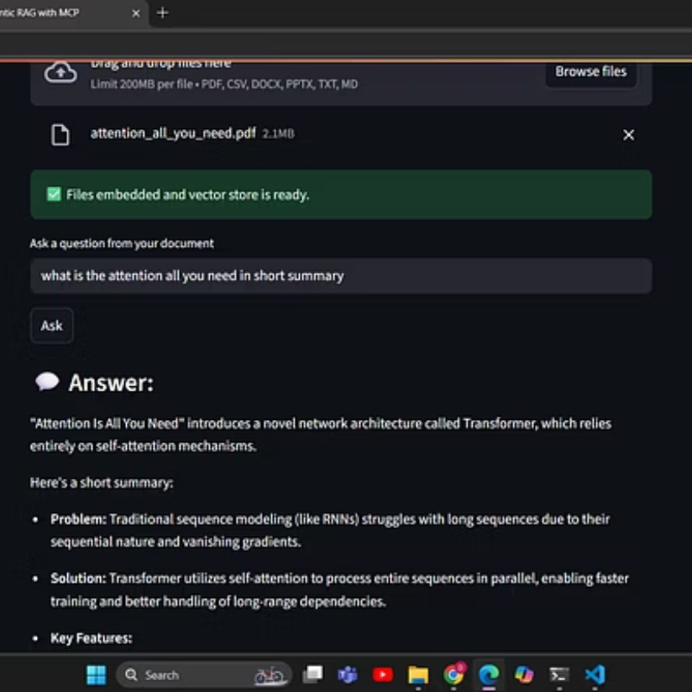
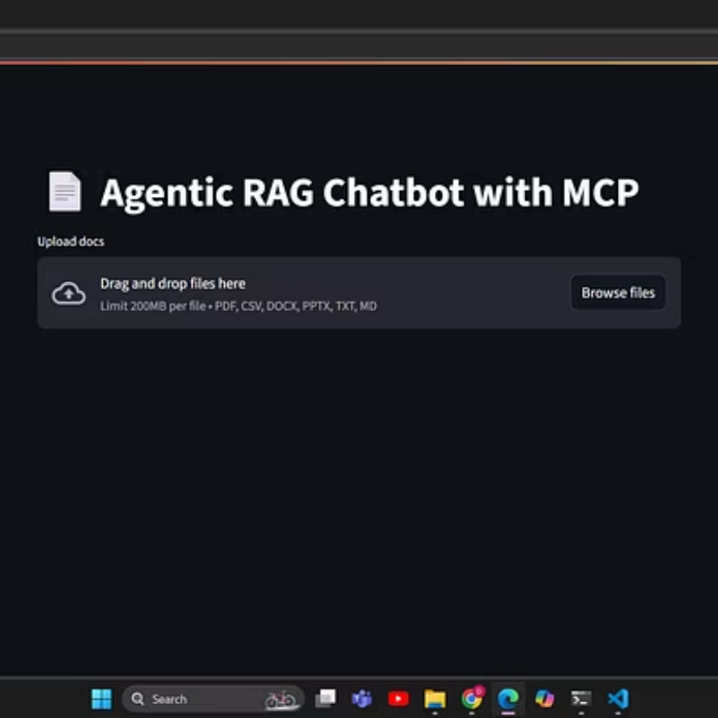
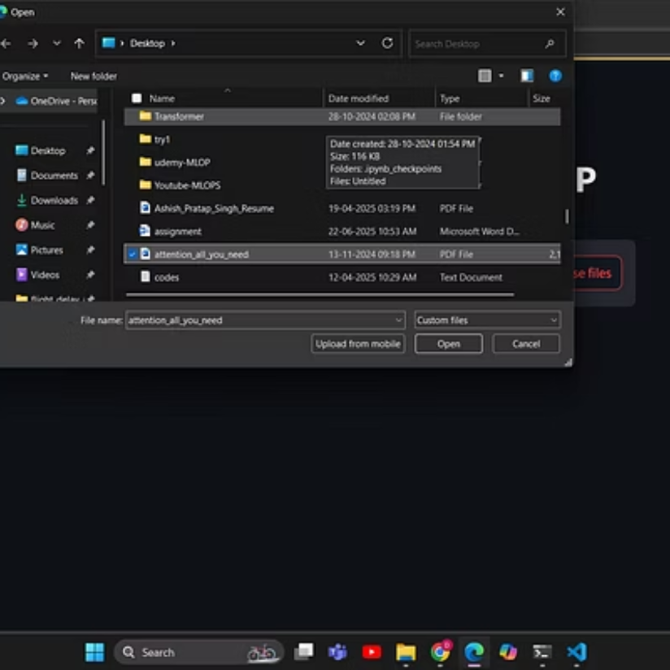
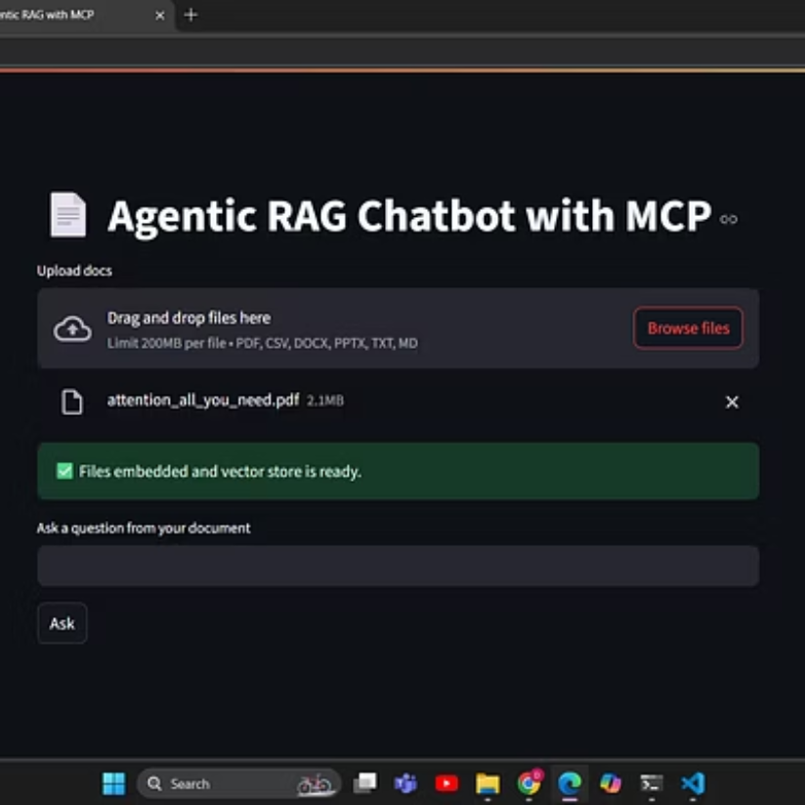
Application Screenshots

Slide 7
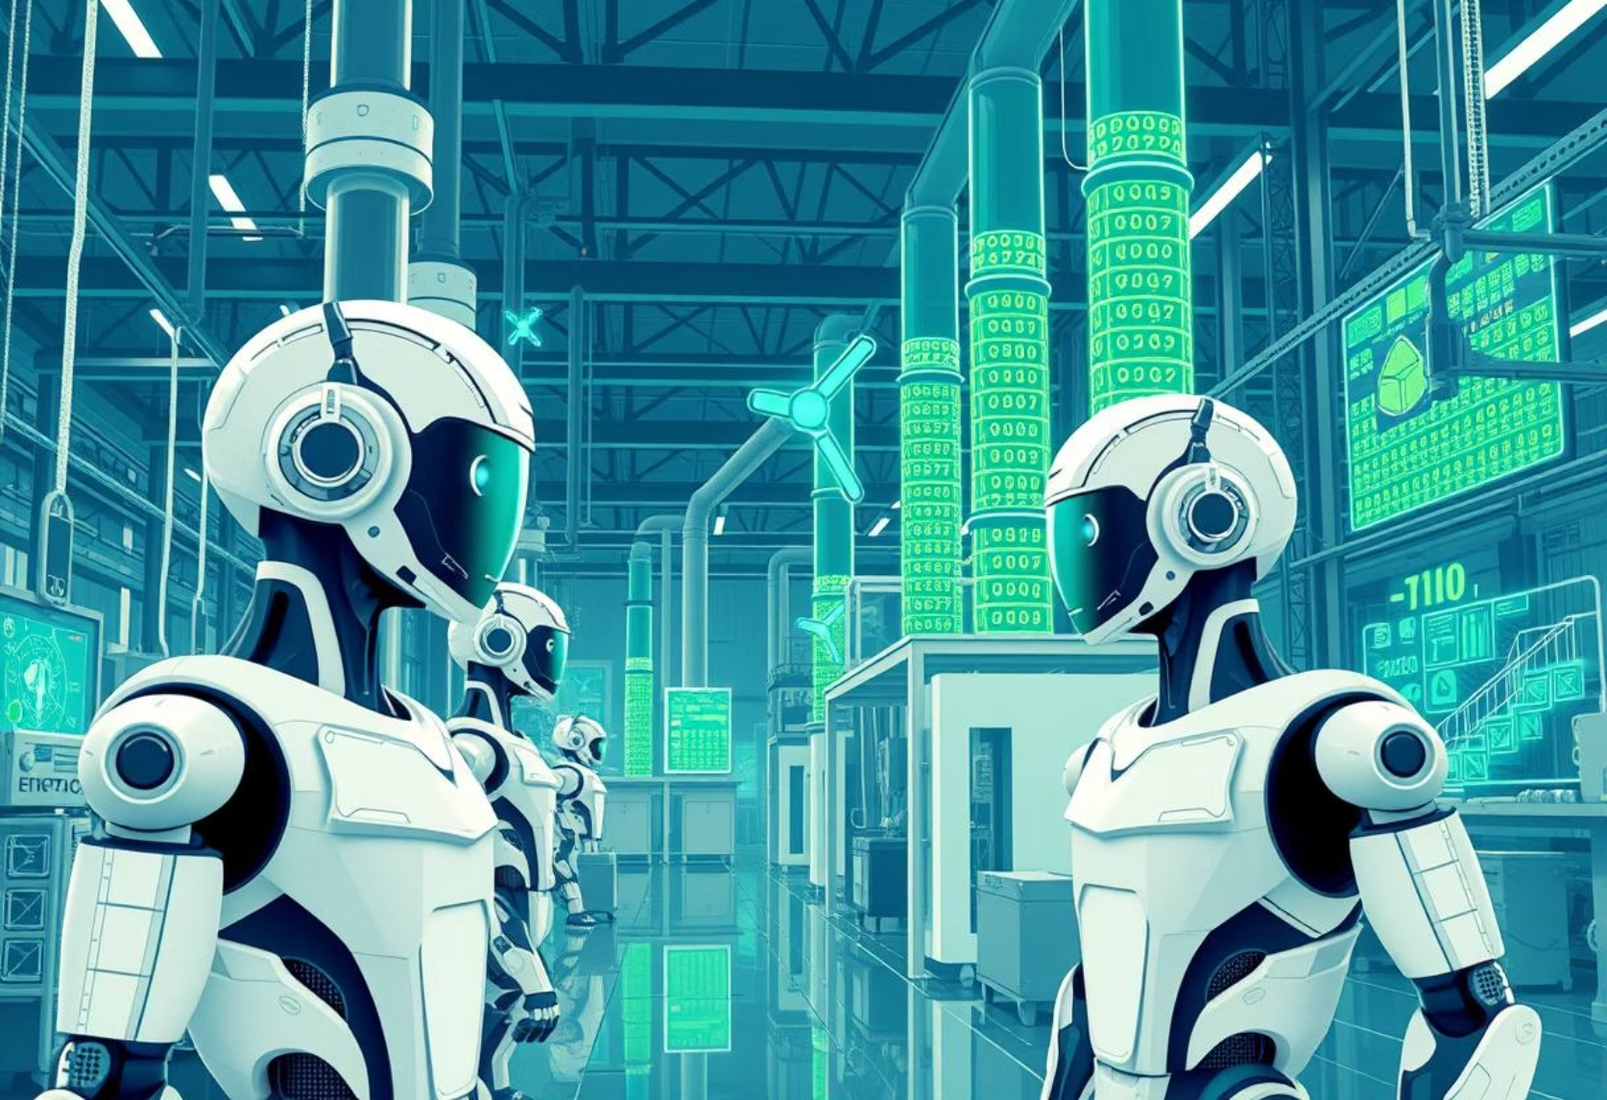
Challenges Faced & Future Outlook
Challenges Faced
Future Outlook
Agent Coordination: Resolved deadlocks via hierarchical arbitration logic within MCP.
Data Consistency: Implemented Two-Phase Commit protocol for critical updates across distributed agents.
Real-time Performance: Optimized message processing for sub-100ms response times for critical operations.
Security: Secured inter-agent communication using mTLS 1.3 encryption and OAuth2 for API endpoints.
Debugging Complexity: Developed custom distributed tracing tools for agent interactions.
Integrate AI-driven predictive maintenance agents.
Expand IROS deployment to 5 new factories by 2025.
Explore machine learning for even greater optimization of resource allocation.
Develop mobile applications for on-the-go monitoring.

